Slide 1
Modeling Tourist Movement Using Lévy Flight
GEOG 8294 Spatiotemporal Modeling & Simulation
Zhiwei Yan

Slide 2
01
Subject
02
Methodology
CONTENTS
03
Work in Progress
04
Outcomes
05
Future Extensions

Slide 3
Subject
Tourist Movement
Importance
Local government & companies: tourism management
Future tourists: travel recommendation
Challenges
Complex
Hard to describe patterns using raw data
One of the efficient method to understand movement patterns and processes is to use simulation models.

Slide 4




Methodology
Conceptual
Model
Data
Collection
Model
Parameterization
Code
Implementation
Sensitivity
Analysis
Model Implementation

Slide 5
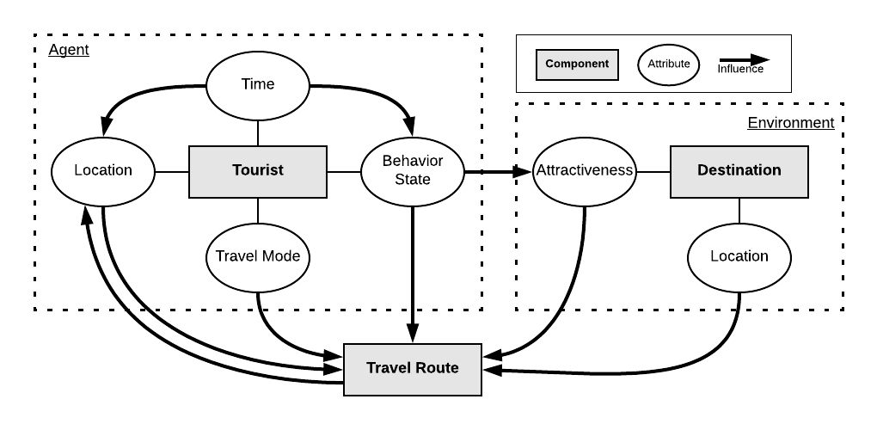

Conceptual Model

Slide 6
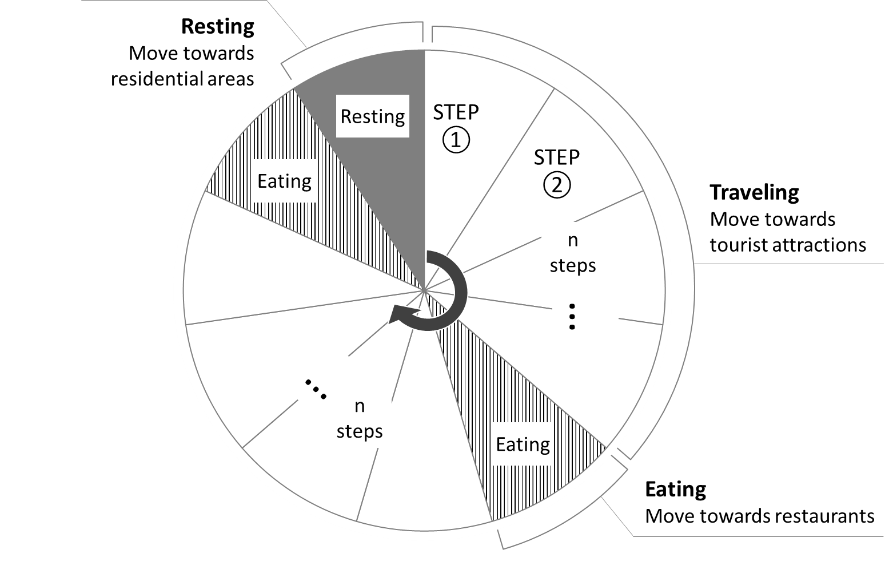
Conceptual Framework
The behavior state is updated based on time and affects the attractiveness of a destination to tourists.

Slide 7




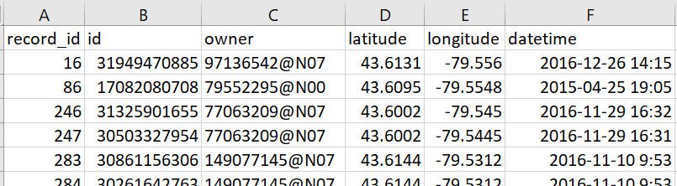

Model Implementation Ⅰ
Data Collection
Study area: City of Toronto - boundary
Tourists
Attractions
Restaurants
Hotels
The geotagged photos shared by tourists on Flickr.
Toronto Open Data
Yelp
Toronto Open Data – Commercial residential area

Slide 8


Model Implementation Ⅱ
Parameterization
Input by users
Time steps tourists travel per day
Length of the trip
Travel mode
Use actual movement observations to parameterize
Movement model
Levy flight model
A power law distribution (exponent value and coefficient)
Truncation (step size limit)

Slide 9

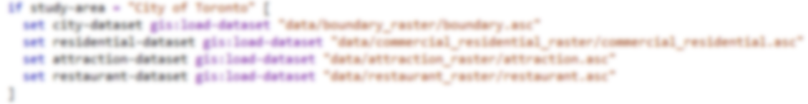
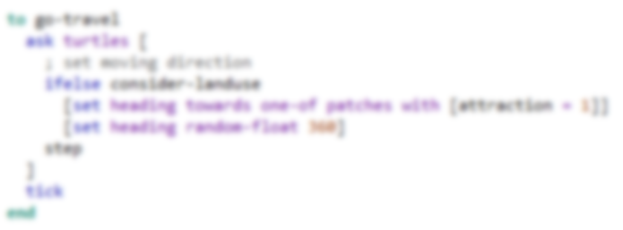
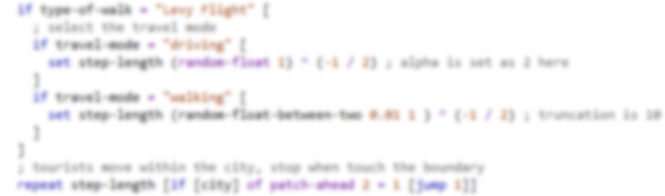

Model Implementation Ⅲ
Code
Load GIS data
Bias: move towards tourist attractions
Truncated Levy flight

Slide 10
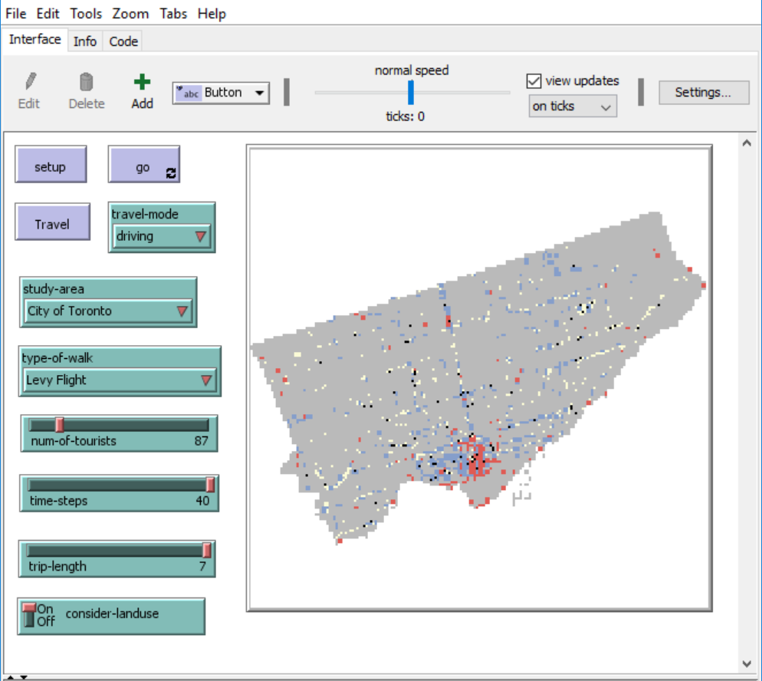
Outcomes

Slide 11
Future Extensions
Consider number of tourist attractions
Combine road network
Include more influencing factors
Age
Purpose

